Slide 1
Earned Income Credit
Pub 4012 – Tab I
Pub 4491 – Lesson 29

Slide 2
Refundable Credit
Refundable credits can reduce tax liability below $0
Refundable credits entered in payment section
  Generate refund even if no tax liability
Notes:
Even if there is no tax liability (i.e. the taxpayer owes no money), the taxpayer can still receive a check from the IRS.

Slide 3
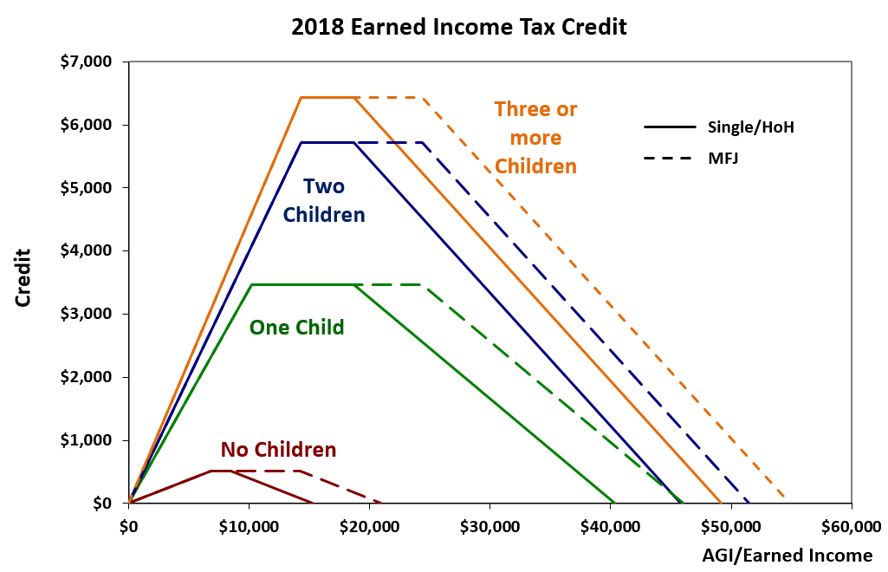
Amount of the Credit
Notes:
EIC applied on bell curve. Little earned income, little credit. Credit increases uphill to a plateau with highest EIC calculated. EIC decreases downhill towards higher income until no longer available.

Slide 4
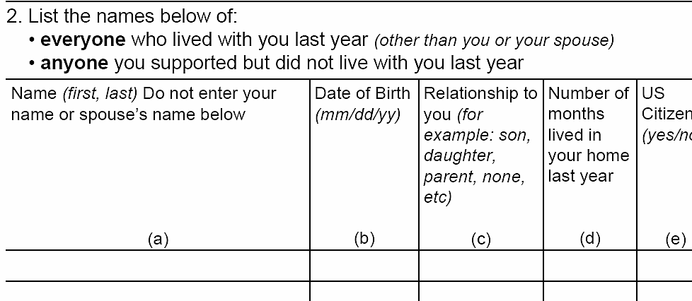
Include All Individuals who Lived in the Home
Include those temporarily away
  School
  Hospital
  Juvenile detention
Notes:
Be sure you find out about ANY family members who lived with them
Avoid questions which require YES/NO answers. Asking who else lived with the taxpayer last year assumes that there will be an answer other than YES or NO.

Slide 5
Two Sets of EIC Rules
Pub 4012 Tab I
Two separate rules for EIC
  Taxpayers with qualifying children (QC)
  Taxpayers without qualifying children
Must have taxable earned income
  Excluded income not eligible for EIC
    Exception: combat pay – Military certification required
Find Summary of EIC Eligibility Requirements in Pub 4102 Tab I
Notes:
Excluded Medicaid waiver payments are disregarded for the credit – it is not taxable earned income

Slide 6
EIC Rules for Everyone
Pub 4012 Tab I
Tax return earned income and AGI need to be within the limitations
  Find Summary of EIC Eligibility Requirements in Pub 4012 Tab I
Everyone on return required to have SSN
  Valid for work only with DHS authorization included
Taxpayer cannot file MFS
Taxpayer must be full year US citizen or resident alien
Notes:
TP = taxpayer QC = qualifying child
SSNs must be good for employment.
Check box in TaxSlayer personal information section stating nonresident alien. Return out of scope without international certification
Taxpayers cannot file an amended return retroactively for any year in which they did not have a valid social security number by the due date of the return (including extensions).

Slide 7
Rules for Everyone (Cont.)
Cannot exclude foreign earned income
  Form 2555 or 2555-EZ
Maximum investment income allowed $3,500
Taxpayer cannot be qualified child of another taxpayer
Notes:
TP = taxpayer QC = qualifying child
SSNs must be good for employment.
Maximum investment amount is adjusted for inflation each year.
Taxpayer can be qualifying RELATIVE of another taxpayer
Must have international certification to file form 2555
2016 added Tip in 4491- pg. 30-2: Taxpayers cannot file an amended return retroactively for any year in which they did not have a valid social security number by the due date of the return (including extensions).

Slide 8
Taxpayer with Qualifying Child
Child must meet all tests
  Relationship
  Age
  Residency
  Not filing MFJ
Married child must be a dependent
Note: Support test does not apply to EIC
Notes:
These tests are in Resource Guide Page C-3
Support is not an issue for EIC—This is an exception to the uniform definition of Qualifying Child.

Slide 9
Taxpayer without Qualifying Child
Taxpayer must be 25 and under 65 on December 31
Cannot be dependent of another taxpayer
Must have lived in US more than half the year
  Military exception
Notes:
*Under 65 as of December 31
Taxpayer without a QC cannot be a dependent at all.
Taxpayer with a QC can be a dependent as qualifying relative, not as a qualifying child

Slide 10
Earned or Not Earned Income for EIC Quiz
Pub 4012 Tab I
Disability pension or annuity when taxpayer is under minimum retirements age?
Taxable long-term disability benefits received prior to minimum retirement age
Nontaxable combat pay
Taxable scholarship or fellowship grants that are not reported on Form W-2
Pay for work performed while an inmate at a penal institution or on work release
Earned – see Pub 4012 Tab D for entries
Earned
Earned if increases EIC/refund
Not Earned
Not Earned – see Pub 4012 Tab D for entries
Notes:
Note inclusion of long-term taxable disability benefits if under retirement age.
Include combat pay only if including it increases the credit.
Earned Income does not include scholarship income or penal income (or while on work release)
* Software Hint : Volunteers using software must check the box in the Rollover or Disability section of the Form 1099-R input screen to report disability as wages.

Slide 11
EIC Calculation
Credit calculated on whichever amount generates smallest credit
  Earned income or
  AGI
2018 maximum EIC $6,431

Slide 12
Qualifying Child of More than One Person
Qualifying child of more than one taxpayer – only one can claim EIC with that child
Follow tie-breaker rules
Taxpayer with qualifying child used by someone else can claim EIC with different child or
Taxpayer can claim EIC without a child
  If all other rules met
Notes:
Tie-breaker rules used to be applied only if two or more people claimed the same child.
Taxpayer Relief Act of 2009 changed that.
Tie-breaker rules now apply all the time—except that either parent (with whom child lived more than ½ the year) can claim the child.

Slide 13
Qualifying Child of More than One Person
Tiebreaker rules: more than one taxpayer can claim a child
  Only one the parent, parent wins
  Both parents can claim child, custodial parent wins
  Child in custody of both parents same amount of time, parent with higher AGI wins
  Neither is parent, taxpayer with highest AGI wins
Use the tri-fold Qualifying Child / Qualifying Relative resource tool – will walk through all requirements
Notes:
Tiebreaker rules kick in when more than one taxpayer actually claims a child.
Custodial parent is the parent the child lives with the majority of the time.

Slide 14
Divorced, Separated or Never Married Parents
EIC goes to custodial divorced, separated or never married parent
  Parent with whom child lived longest
  Child must have lived with parent over half the year

Slide 15
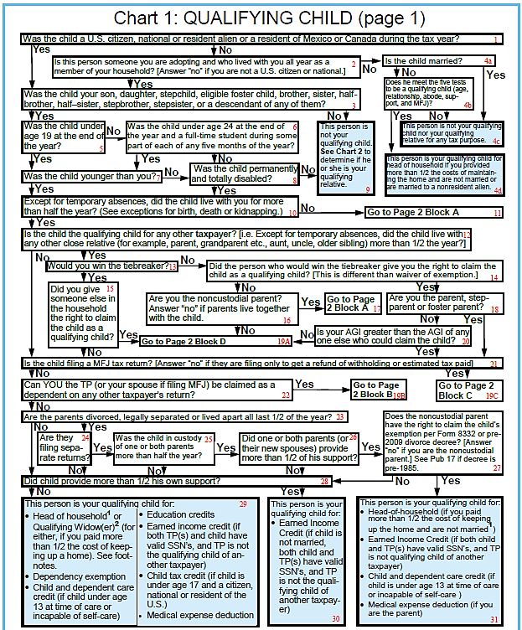
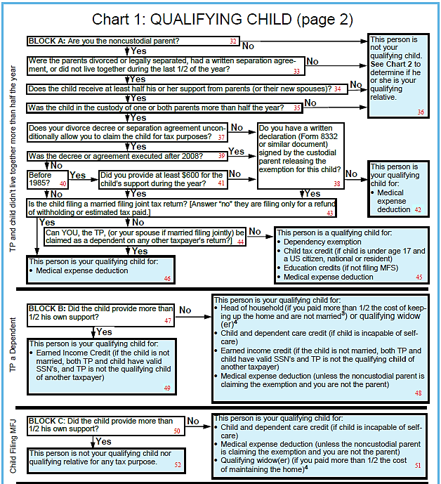
Qualifying Child Chart:
Notes:
Must be a qualifying child—not a qualifying relative.

Slide 16
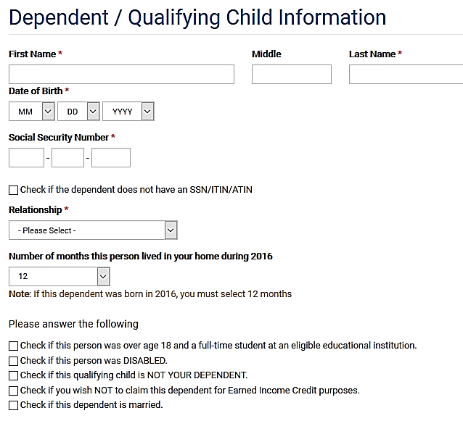
Entering Dependent/QC Information in TaxSlayer
Taxpayers and qualifying children must have SSN valid for employment
Check if NOT claiming EIC for dependent
Notes:
Note the check box is to NOT CLAIM the dependent for EIC purposes
Class should become familiar with these additional dependent questions as they impact EIC and other tax benefits
They are presented here as not in initial Pub 4012

Slide 17
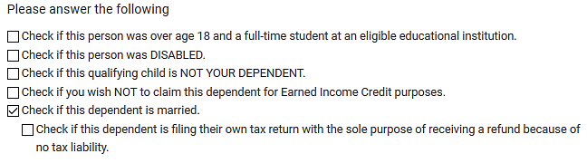
EIC and Dependency TaxSlayer
Read carefully
Check if qualifying child for EIC but NOT a dependent
Notes:
Child provided over half their own support so not a dependent BUT qualifying child for EIC

Slide 18
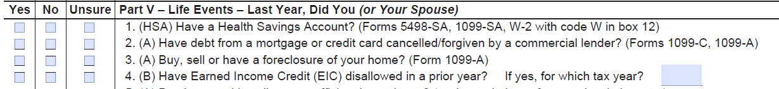
EIC Disallowed in Prior Year
Check Intake Booklet
Ask if EIC disallowed in prior year
  Must file Form 8862 if other than math error

Slide 19
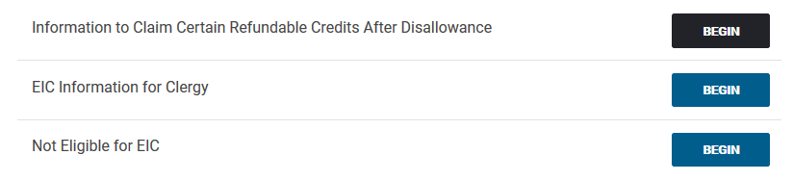
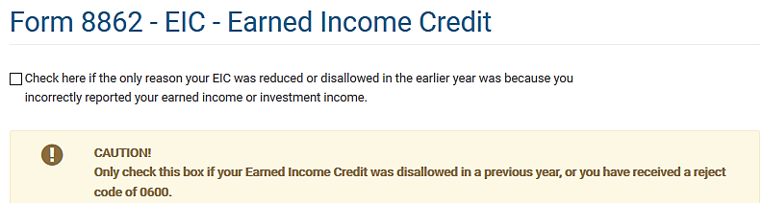
EIC Disallowed in Prior Year
Check if EIC
reduced or disallowed
ONLY due to
misreported income
Notes:
If EIC denied due to reckless or intentional disregard or EIC rules, taxpayer cannot claim EIC for 2 tax years.
If due to fraud, cannot claim EIC for 10 years.

Slide 20
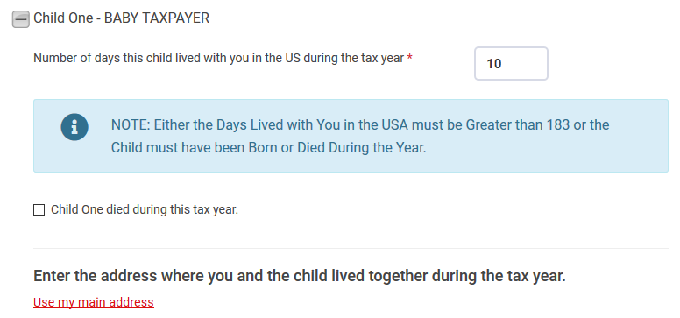
EIC Disallowed in Prior Year
Answer questions for each child separately

Slide 21
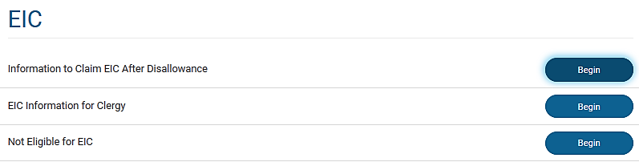
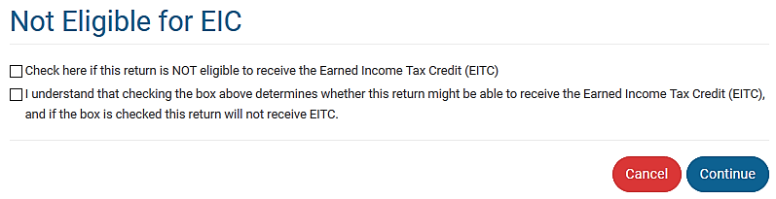
Taxpayer Not Eligible for EIC
Enter here if taxpayer is a qualifying child of another taxpayer

Slide 22
Quality Review
All qualifying children included on return
  Temporary absences
  Child providing over half of own support
  Permanently disable children or siblings
Prisoner income identified
Schedule EIC and Worksheet complete and correct

Slide 23
Exit Interview
No refunds issued on EIC returns until February 15
  Prepare return, E-file and alert taxpayer to refund delay
Advise taxpayer if EIC ending
  Child under 19 or
  Under 24 and full-time student
Tax year 2018 birthdates to watch
  2000 and 1995 (full-time student)

Slide 24
Quiz 1
Tom is 32 years old
He cannot work and lives with his parents
He receives social security disability checks, which he uses to pay his parents for his room and board and for his clothes and entertainment
Can his parents claim him as a dependent?
Can they claim him for EIC?
Notes:
Use Qualifying Child charts to find answers about QCs
Not as a dependent: he provides more than half of his support.
Yes for EIC: the support test does not apply.
Tom provides over half his own support
Tom is permanently and fully disabled

Slide 25
Quiz 1 Answer
Not as a dependent: He provides more than half of his own support
Yes for EIC: The support test does not apply

Slide 26
Quiz 2
John and Mary have ITINS, but their two children have valid social security numbers
Can John and Mary claim the children as dependents?
Can they claim them for EIC?
Notes:
Yes for dependency
No for EIC—must have social security numbers

Slide 27
Quiz 2 Answer
Yes – Meet all requirements for dependency
No – Both taxpayer and QC must have SSNs to qualify for EIC

Slide 28
Quiz 3
Mary has always claimed her daughter Susan, 18, as a dependent and for EIC
In November, Susan got married and plans to file MFJ with her husband
Can Mary claim Susan as a dependent?
Can she claim Susan for EIC?
Notes:
No, MFJ disqualifies for dependency
No, if married, child must be a dependent.
NOTE: If class is ready, discuss possibility of Susan and husband filing MFS. Could make a big difference in total refunds for the family.

Slide 29
Quiz 3 Answer
No – MFJ (unless filing only to claim a refund of withholding or estimated tax) disqualifies for dependency
No – If married, child must be a dependent
Notes:
NOTE: If class is ready, discuss possibility of Susan and husband filing MFS. Could make a big difference in total refunds for the family.

Slide 30
Quiz 4
70-year old worker with no children at home has earned income of $10,000
TaxSlayer does not give him any EIC
Is this correct?
Notes:
Yes, without a child, must be between 25 and 65.

Slide 31
Quiz 4 Answer
Yes – Without a child, taxpayer must be at least 25 but under 65 to qualify for EIC

Slide 32
Quiz 5
Bill is 30 years old and earned $33,000; his wife, Emily, is 27 and earned $1,000
Bill and Emily have three children under age 19 who lived with both of them until August when they divorced
The children lived with Emily through the rest of the year
Who is eligible to claim EIC?

Slide 33
Quiz 5 ANSWER
Emily is the one eligible to claim all
  The children lived with her the longest (tiebreaker)
  She could choose to let Bill claim them
Bill could claim some or all of the children if Emily does not claim them (lived with Bill more than ½ the year and AGI not an issue between parents, except as a tiebreaker)

Slide 34
Earned Income Credit
Questions?
Comments…

